Slide 1

title
DEPARTMENT OF BIOMEDICAL ENGINEERING
POSTURE DETECTION WITH VIBROTACTILE FEEDBACK
UNDER THE GUIDANCE SUBMITTED BY
P . RAJALAKSHMI KAVIYA S - 113123UG01024
ASSISTANT PROFESSOR POOVIZHI K - 113123UG01041
KAVYA KAMATCHI V - 113123UG01025

Slide 2
Aim
To design a wearable posture monitoring system
To detect spine bending using sensors
To provide real-time vibrotactile feedback
To help users maintain correct posture.

Slide 3
Objective
To measure body tilt using MPU6050 sensor
To calculate spine bending angle
To set a threshold limit for posture
To alert user using vibration motor
To indicate posture status using LCD
To develop a low-cost embedded system

Slide 4
Scope
Can be used by students and office workers
Helps prevent back pain and posture-related problems
Useful in physiotherapy and rehabilitation
Can be upgraded with mobile app integration
Can be used in smart wearable devices

Slide 5
Literature Review
S. No | SOURCE | PURPOSE | RESULT
1 | Wearable Real-Time Intelligent Posture Corrective System Using Vibrotactile Feedback (2011) | Real-time posture monitoring and correction | Vibration alerts Improved posture through vibration alert
2 | Intelligent Vibrotactile Biofeedback System (2012) | Posture correction on un-stable surface | Better balance and posture control achieved
3 | Wearable Posture Monitoring System with Vibration Feedback (2018) | Continuous posture tracking | Real-time detection and correction possible

Slide 6
Literature Review
S. No | SOURCE | PURPOSE | RESULT
4 | Reducing Postural Load in Order Picking Through a Smart Workwear System Using RealTime Vibrotactile Feedback (2020) | Improve worker posture during industrial tasks | Reduced adverse trunk and upper arm postures; users found the system comfortable and effective
5 | Real-Time Human Posture Recognition Using Inertial Sensors (2017) | Detect body orientation and posture changes | High recognition accuracy with low computational cost
6 | Posture Monitoring System Using MPU6050 and Arduino (2021) | Low-cost posture correction device | Accurate detection of forward bending posture

Slide 7
Summary of Literature
Existing systems focus on monitoring posture
Many systems are expensive or complex
Real-time feedback is limited in some designs
Need for affordable and wearable solution
Proposed system provides simple and effective feedback

Slide 8
Methodology
Methodology (Step 1) :
MPU6050 sensor placed on lower back
Sensor measures acceleration values
Data sent to Arduino using I2C communication
Arduino processes the sensor data

Slide 9
Methodology
Methodology (Step 2) :
Angle calculated from sensor values
Compared with predefined threshold
If angle exceeds limit:
Vibration motor activated
Buzzer and LCD turns ON
If posture is correct:
Motor OFF
Buzzer and LCD OFF

Slide 10
Novelty in Research Proposal
Introduces a real-time posture correction system using vibrotactile feedback
Combines MPU6050 sensor with a simple embedded controller for accurate angle detection
Provides instant vibration alert instead of only monitoring (active correction approach)
Designed as a low-cost and portable wearable device
Uses threshold-based intelligent feedback mechanism
Simple design compared to complex IoT or camera-based systems

Slide 11
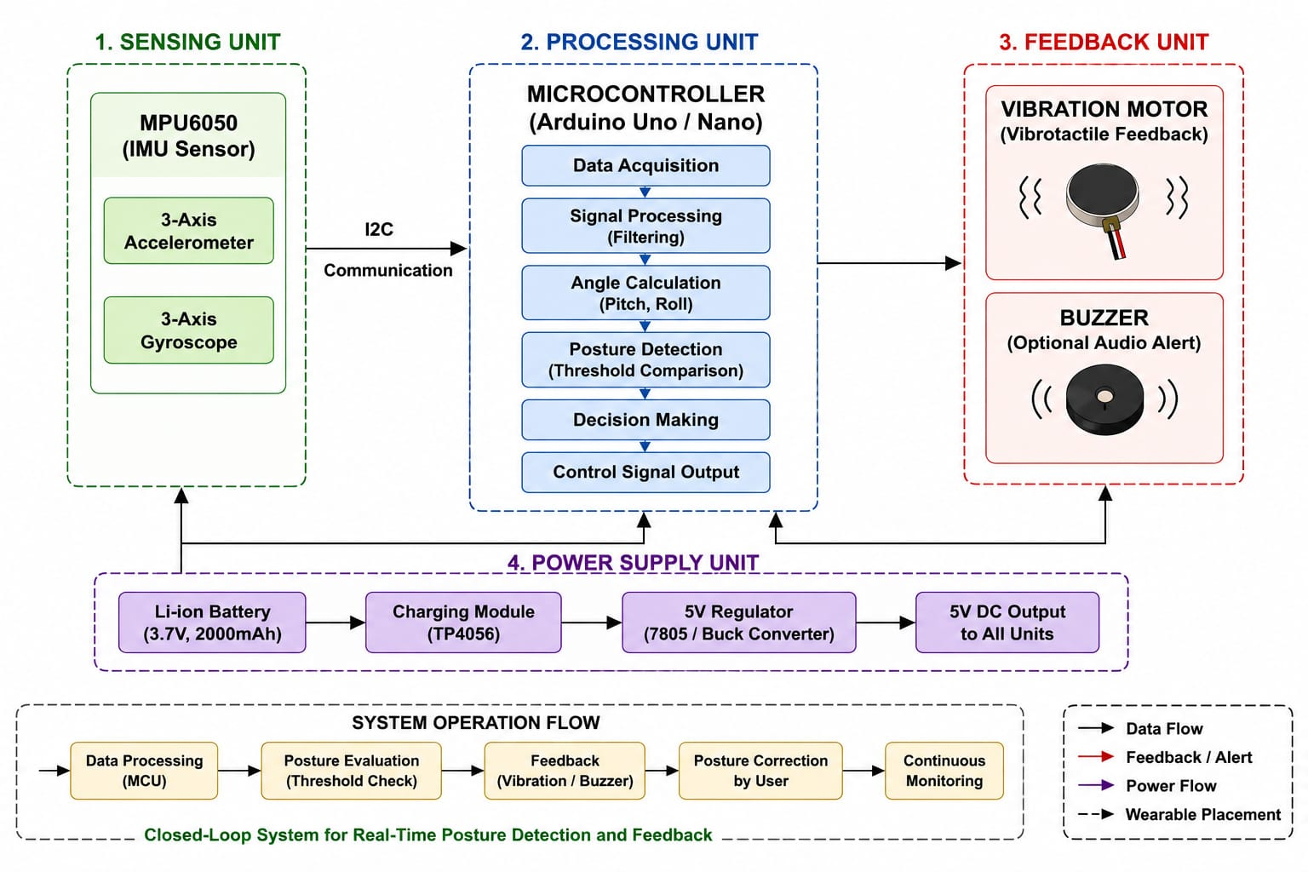
Block Diagram

Slide 12
Block Diagram Explanation
Sensor detects body movement and tilt
Arduino receives and processes data
Angle is calculated using formula
Compared with threshold value
If posture is incorrect:
Motor vibrates
Buzzer gets ON and LCD display “Posture Incorrect”
Provides instant feedback to use

Slide 13
Result
System detects posture accurately
Real-time monitoring achieved
Vibration feedback works properly
LCD indication is clear
System responds quickly
Observation:
➢Correct posture → No vibration
➢Incorrect posture → Immediate alert
➢Stable performance during testing
➢Works continuously without delay

Slide 14
Discussion
System is simple and efficient
Low power consumption
Accuracy depends on sensor placement
Threshold value can be adjusted
Useful for daily posture correction

Slide 15
Conclusion
Provides real-time vibrotactile feedback
Helps improve posture habits
Prevents long-term spinal issues
Cost-effective and user-friendly

Slide 16
Future the Scope
Integration with mobile application
Use of AI for posture analysis
Wireless communication (Bluetooth)
Smaller and more compact design
Data storage and tracking system

Slide 17
References
Gopalai, A. A., & Senanayake, S. M. N. A., "A Wearable Real-Time Intelligent Posture Corrective System Using Vibrotactile Feedback," IEEE/ASME Transactions on Mechatronics, 2011.
Zheng, Y., & Morrell, J., "A Vibrotactile Feedback Approach to Posture Guidance," IEEE Haptics Symposium, 2010.
Xu, J. et al., "Configurable Wearable Sensing and Vibrotactile Feedback System for Real-Time Postural Balance and Gait Training," JNER, 2017.
Lins, C. et al., "A Wearable Vibrotactile Interface for Unfavorable Posture Awareness Warning," ICT4AWE, 2018.
Ishac, K., & Suzuki, K., "LifeChair: A Conductive Fabric Sensor-Based Smart Cushion for Actively Shaping Sitting Posture," Sensors, 2018.
Kim, W. et al., "A Directional Vibrotactile Feedback Interface for Ergonomic Postural Adjustment," IEEE Transactions on Haptics, 2021.

Slide 18
Thank you

